Slide 1
AWS Account –Set up

Slide 2
Overview
An AWS account is required to access AWS services as two basic function:
1. Container: contains all your resources each uniquely identified by a ARN number
2. Security boundary :
→ Provides basic security boundary for your resources that you create in your account.
→ We can create IAM users and roles later to whom we can attach permission policies defining what that person can do in your AWS account.

Slide 3
Create your AWS Account
Signup URL: https://portal.aws.amazon.com/billing/signup#/start/email
For training we for personal account(No difference between personal or business account and configuration can be changed later by contacting AWS support.)
Select basic support plan which is free.

Slide 4
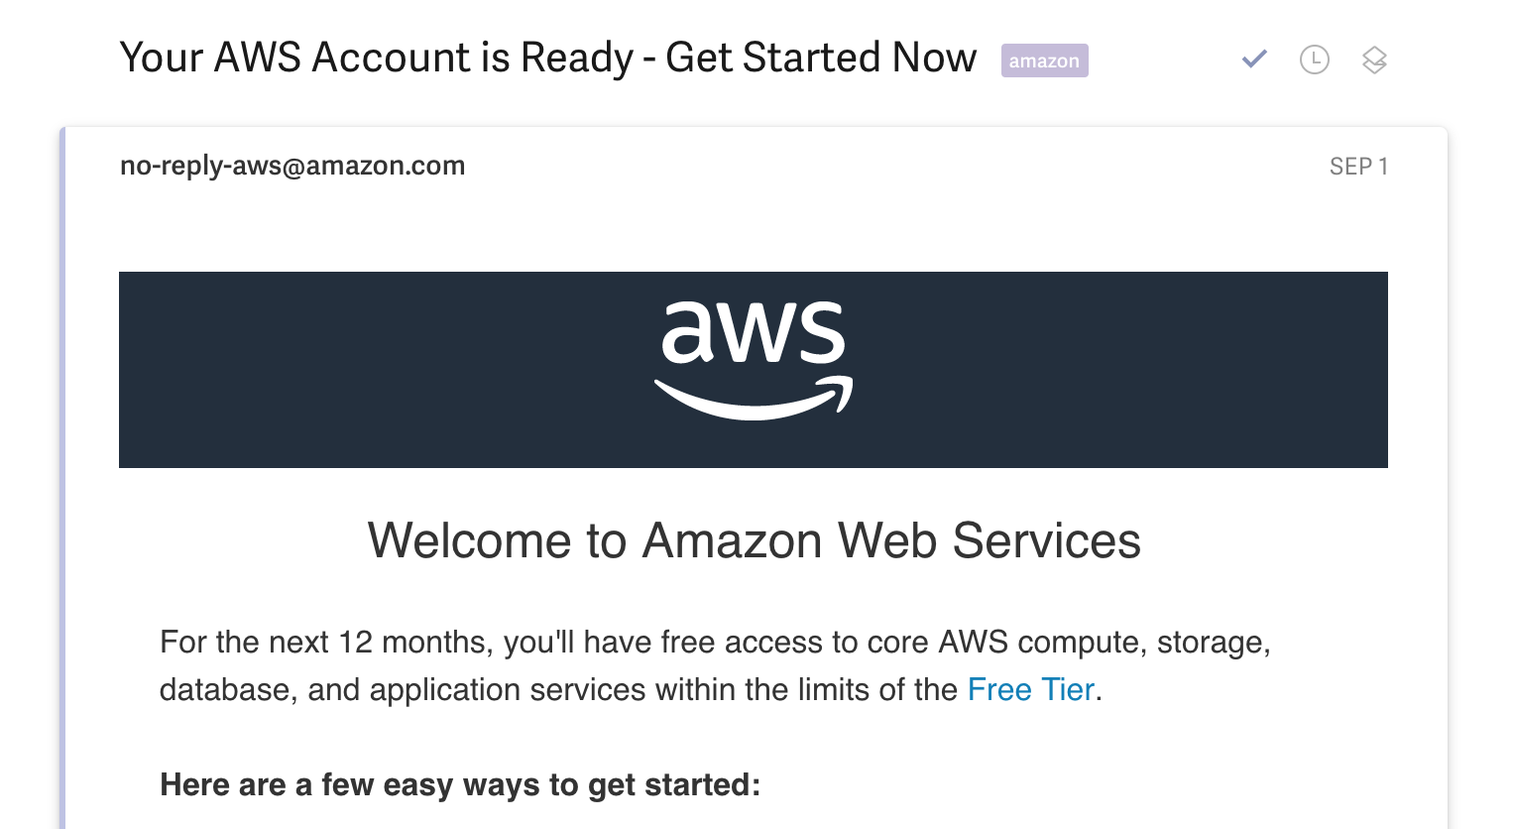
AWS Account Activation Troubleshooting
Ensuring your AWS Account is activated
The activation email looks like this (the content might be slightly different for you):

